Slide 1

Thymeleaf
http://www.thymeleaf.org/

Slide 2
Introducing Thymeleaf
It's a Java Template Engine
Can be used as view layer in Spring MVC
First stable release: July 2011
Currently: 2.0.x
Elegant, configurable, extensible
21st-century feature set
FUN TO USE!

Slide 3
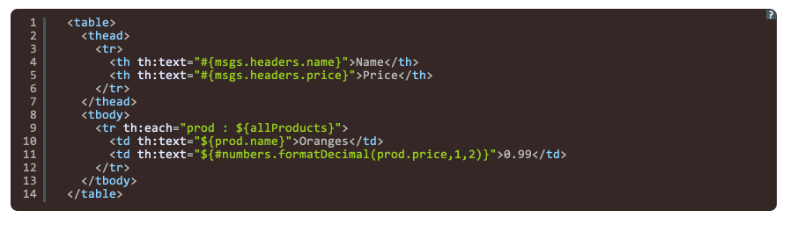
How does it look like?

Slide 4
Standard and SpringStandard Dialects
XML, XHTML 1.0, XHTML 1.1 and HTML5 support.
Complete substitute for view-layer web technologies such as JSP.
Easy-to-use, elegant syntax based on attributes only (these dialects include no tags).
Great for web templates: <input type="text" th:field="*{name}" /> instead of <mylib:text field="name" />
Natural templating for easy prototyping: display your templates statically in a browser (without running your app server).
Expression evaluation: OGNL (Standard) and Spring Expression Language (SpringStandard).
Complete integration with Spring MVC (SpringStandard): form binding, property editors, internationalization, etc.
Spring WebFlow support (including AJAX events).

Slide 5
Standard and SpringStandard Dialects
Fully-featured template logic: iteration, conditional evaluation, context variable declaration, etc.
Several options for layout (Composite View pattern):
A builtin mechanism (Thymeleaf's native fragment inclusion).
Specific Apache Tiles integration (through extras package).
Can be used along with SiteMesh.
Internationalization support: easy inclusion of externalized messages into templates.
URL rewriting capabilities for adding context and session information to URLs.
JavaScript and Dart inlining: intelligent evaluation of expressions inside javascript/dart code.
Template validation support for XML, XHTML 1.0 and XHTML 1.1.

Slide 6
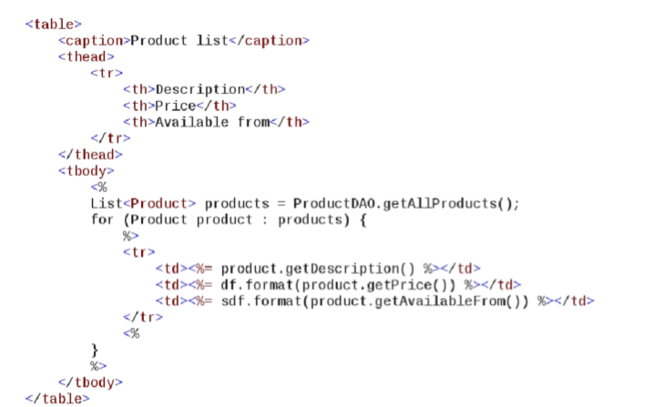

Can Jsp do it?

Slide 7
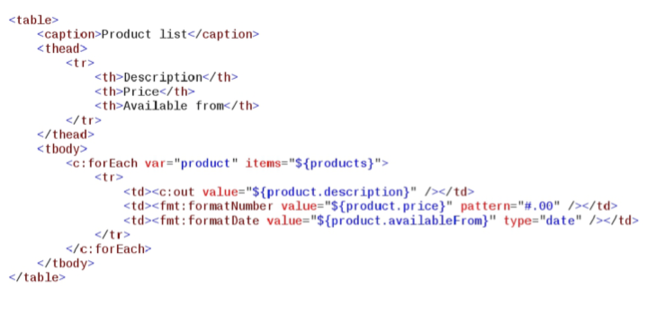
Can JSP+JSTL Do it?

Slide 8
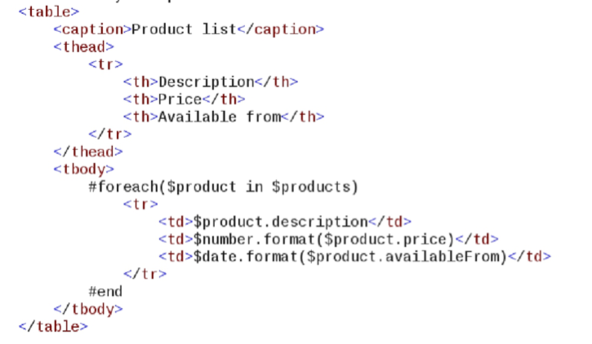
Can Velocity do it?

Slide 9
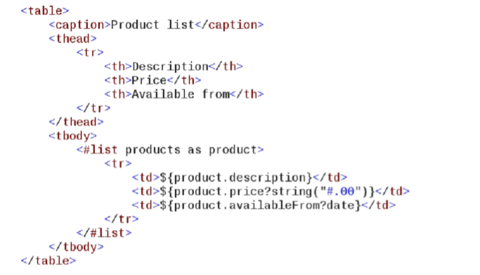
Can FreeMarker Do it?

Slide 10
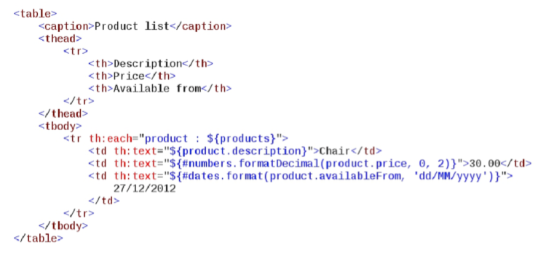

...Can Thymeleaf do it?

Slide 11
How do we evaluate it?
“valid document, don't break structure”
Templates should be statically displayable
Static = Open in browser, no web server
Templates should work as prototypes

Slide 12
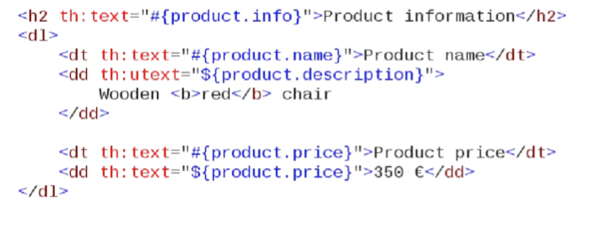
Texts
th:text HTML-escaped text (default)
th:utext unescaped text

Slide 13
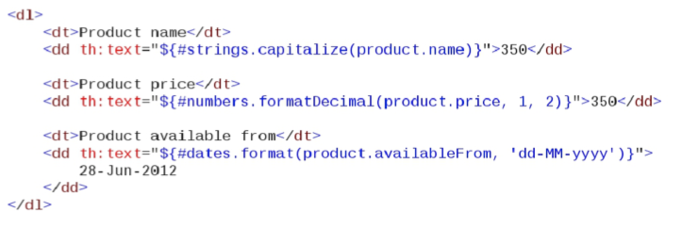
Formatting
#dates, #calendars, #numbers, #strings...

Slide 14
URLs
@{...} syntax
Automatic URL-rewriting is performed

Slide 15
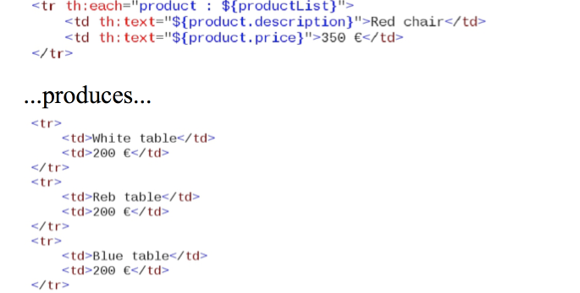
Iteration
th:each

Slide 16
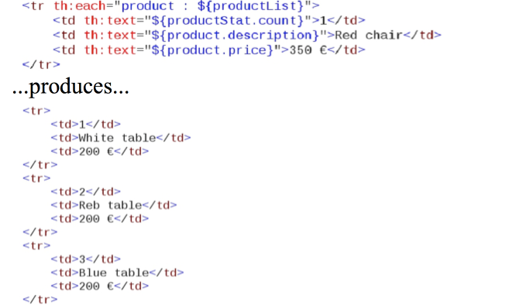
Iteration status
th:each

Slide 17
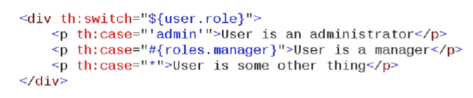
Conditionals
th:if
th:unless
th:swithc/th:case

Slide 18
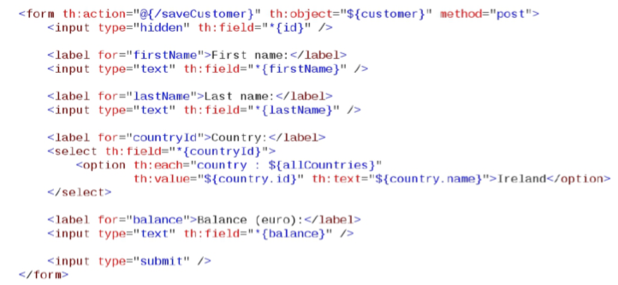
Forms and bean-binding
th:object, th:field

Slide 19
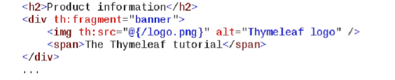

Page compostion
Declare fragment with th:fragment
Resuse th:include

Slide 20
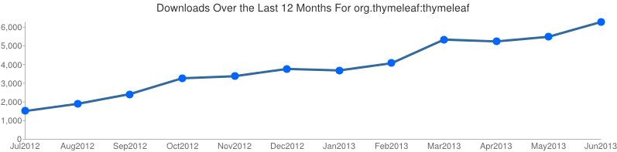








Who is using Thymeleaf?

